Slide 1
Appellate Decisions of Interest to the DOE Complex; Price Anderson after Cook
Mike Vernick & Mary Anne Sullivan
Hogan Lovells US LLP
July 21, 2016
Notes:
Note – 3D supergraphic ‘mask’ is now a selectable object in foreground of slide.

Slide 2
Agenda
The Supreme Court’s Escobar decision on implied certification
DoJ policy developments
Other decisions of note
Price Anderson after Cook

Slide 3
Implied Certification
Universal Health Services, Inc. v. United States ex rel. Escobar, 136 S. Ct. 1989 (2016)
Medicaid beneficiary died after receiving counseling services and prescription drugs from a Massachusetts mental health facility
Parents filed a qui tam suit alleging that
The facility employed a number of unlicensed caregivers whose jobs required that they be licensed
Some of those unlicensed caregivers obtained a National Provider Identifier number by misrepresenting their status and that one of those unlicensed caregivers wrote prescriptions for their daughter that contributed to her death
The facility’s claims for services submitted to Massachusetts Medicaid were false claims because the facility was required by regulation to employ licensed providers in positions the facility filled with unlicensed caregivers
Hogan Lovells
| 3

Slide 4
Implied Certification (cont’d)
The case provided the Court an opportunity to resolve a circuit split on the issue of whether implied certification is a basis for FCA liability
E.g., does a claim include an implied certification of compliance with underlying statutes, regulations, or contract requirements
Seventh Circuit had rejected the theory outright
Second Circuit had held that the theory was viable only when the relevant legal requirement was expressly stated to be a condition of payment
In the decision under review by the Court, the First Circuit had held that any claim submitted by a provider “implicitly communicate[s] that it conformed to the relevant program requirements, such that it was entitled to payment,” and that any knowing misrepresentation (either express or implied) of compliance with material conditions of payment makes that claim fraudulent. 780 F.3d 504, 514 & n.14 (1st Cir. 2015).
First Circuit also had held that the legal requirements allegedly violated by the defendant were per se “material” to the government’s payment because the state regulations at issue made those requirements conditions of payment
Hogan Lovells
| 4

Slide 5
Implied Certification (cont’d)
A unanimous Court recognized, but then significantly limited, the scope of implied certification liability
Rejected arguments seeking to expand liability to include any violation of a statute, regulation, or contract term that might lead the government to deny payment of a claim
Two conditions for a viable theory of falsity. 136 S. Ct. at 1993-94.
Interpreting the FCA’s prohibition of “false or fraudulent” claims under the common law definition of fraud, the Court held that a defendant can be liable for a failure to disclose non-compliance with a legal requirement only if two conditions are satisfied:
The defendant’s claim not only requests payment but makes “specific representations about the goods or services provided” and
The defendant’s failure to disclose non-compliance with legal requirements makes those representations misleading
Both conditions met in this case
Hogan Lovells
| 5

Slide 6
Implied Certification (cont’d)
Real limit on implied certification theory derives from the Court’s articulation of the gatekeeping role played by “materiality” in analyzing FCA liability
The Court held that FCA liability can arise from violation of a legal requirement only if the non-compliance with that requirement actually matters to the government’s decision to pay, and the defendant knew that it would
Described this materiality test as “rigorous” and “demanding”
Relying on established common law sources, the Court held: “[U]nder any understanding of the concept, materiality ‘looks to the effect on the likely or actual behavior of the recipient of the alleged misrepresentation.’” 136 S. Ct. at 2002.
In other words, it is not enough to show, as the Government and Relator argued, that non-compliance could have had an effect on a payment decision; instead, the plaintiff must show that non-compliance would actually have had an effect on a payment decision to state a claim under the implied certification theory
Hogan Lovells
| 6

Slide 7
Implied Certification (cont’d)
Does the government actually pay?
The Court explained that proof of materiality can include evidence that the defendant knows the government consistently refuses to pay claims based on non-compliance with the legal requirement at issue
Conversely, the government’s routine payment of claims despite actual knowledge that a requirement is being violated is “very strong evidence” that the requirement is not material
Leaves open the question of what such evidence would look like
Express condition of payment is relevant, not conclusive.
The Relator and the Government argued that FCA liability arises whenever someone bills the government for an item or service while violating a legal requirement that is an express condition of payment under law, regulation, or contract
The Court rejected this argument, concluding that “not every undisclosed violation of an express condition of payment automatically triggers liability.” 136 S. Ct. at 2002. The opinion adds that if any express condition of payment triggered FCA liability, then the government could simply designate all legal requirements as express conditions of payment
However, the Court acknowledged that the government’s decision to expressly identify a legal requirement as a condition of payment is “relevant” to whether the requirement is material to the decision to pay
Minor or insubstantial requirements are not actionable.
Court states repeatedly that the FCA’s treble damages and other penalties are not intended to punish “insignificant regulatory or contractual violations” that fall short of fraud, as defined under the common law. 136 S. Ct. at 2004.
Hogan Lovells
| 7

Slide 8
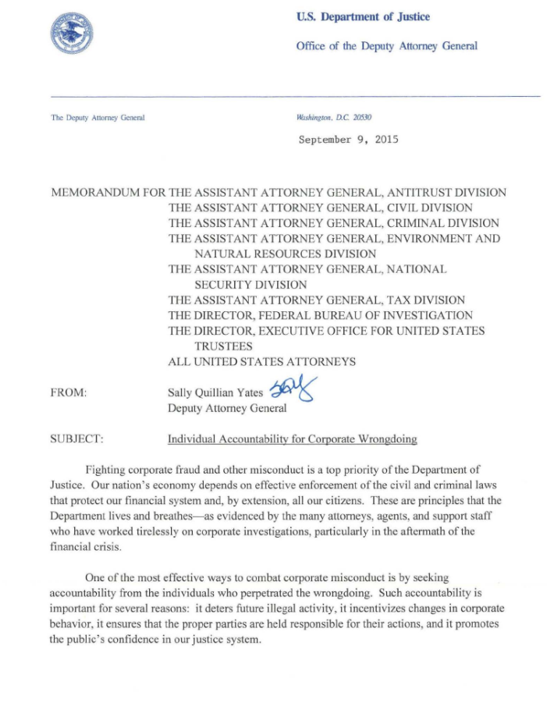
The Yates Memorandum
Memorandum from Deputy Attorney General Sally Yates signals increased scrutiny of individuals
Hogan Lovells
| 8

Slide 9
FCA penalties increase
Through an interim final rule published on June 29, 2016, DOJ will nearly double the FCA’s statutory penalties
Under the FCA, each false claim presented to the government gives rise to a separate civil monetary penalty
As of August 1, the minimum penalty for each false claim will increase from $5,500 to $10,781, and the maximum penalty for each false claim will increase from $11,000 to $21,563

Slide 10
Rule of Two
Kingdomware Technologies, Inc. v. United States, 136 S. Ct. 1969 (2016)
The Veterans Benefits, Health Care, and Information Technology Act of 2006 required the VA to establish annual goals for contracting with veteran-owned businesses
Kingdomware competed unsuccessfully for a VA award under a GSA FSS Schedule contract and subsequently filed a bid protest at the GAO
Asserted that the VA had violated the “Rule of Two,” which says that a contract must be set aside if the CO reasonably expects that two VA-owned businesses will submit offers and can provide a fair and reasonable price
GAO agreed but the VA declined to follow the recommendation
Kingdomware then sought injunctive relief at the U.S. Court of Federal Claims (COFC), 107 Fed. Cl. 226 (2012), which ruled in the government’s favor and was affirmed by the Federal Circuit, 754 F.3d 923 (Fed. Cir. 2014)
Federal Circuit held that the Rule of Two applied only to contracts necessary to meet annual goals, not all contracting actions

Slide 11
Rule of Two (cont’d)
The Court unanimously ruled in favor of Kingdomware
Addressed the cases and controversies issue by explaining that even though there was no “live” controversy the Court had jurisdiction under the “capable of repetition, yet evading review” exception. 136 S. Ct. at 1976.
Found that the Rule of Two was mandatory for all contracting actions
The VA cannot avoid the rule by arguing it has already met its goals or that that FSS buys are exempt
Underscored that “shall” means “shall”
Rejected reliance on the statute’s prefatory clause
Recognized that GSA FSS orders are not just for “griddles or slicers . . .”
Used for major acquisitions

Slide 12
Statistical sampling
U.S. ex rel. Michaels v. Agape Senior Community, Inc., 15-2145 & 15-2147 (4th Cir.)
Qui tam alleged a scheme to submit claims to Medicare, Medicaid and Tricare for hospice and nursing home inpatient services; claims were allegedly false because the care was not medically necessary and/or the certifications required to obtain reimbursement were falsified
Question of whether the plaintiffs could use the statistical sampling model to prove liability and damages arose during discovery; court noted the extensive (50,000+) non-related claims in the case and the time it would require to review those claims
Ruled that statistical sampling was not appropriate, because (1) each claim presented a separate question of whether services furnished were medically necessary; (2) answering that question for each claim would be a fact-intensive inquiry involving expert testimony and review of each patient’s medical chart; and (3) the medical charts of each patient for which the false claims available for review by the parties
Case was ultimately resolved for $2.5M and the settlement was presented to DoJ for approval; even though it declined the case, DoJ objected to the settlement on the basis that it’s own “statistical” sampling generated a substantially higher value
The case is now on appeal before the Fourth Circuit and has generated substantial amicus interest

Slide 13
Jurisdictional issues
Dourandish v. United States, 629 Fed. 966 (Fed. Cir. 2015)
Quimba Software, Inc. entered into a cost-plus-fixed-fee contract with the Air Force signed by its co-owner in his capacity as a company officer
After the period of performance, the Air Force raised certain cost allowability questions and the contracting officer ultimately issued a final decision claiming entitlement of roughly $92,000
Quimba Software challenged the Government's claim at the COFC and the co-owner filed a separate suit as an individual in which he alleged breach of contract and interference with constitutional right to seek federal contracts
The COFC dismissed the individual case on jurisdictional grounds
The Federal Circuit affirmed on the basis that the owner of Quimba Software was not a party to the contract between the company and the Air Force; as a result the COFC had no jurisdiction

Slide 14
Jurisdictional issues (cont’d)
Fidelity and Guaranty Ins. Underwriters, Inc. v. United States, 805 F.3d 1082 (Fed Cir. 2015)
Gibbs Construction, LLC entered into an asbestos abatement contract with the U.S. Postal Service
At some point, insurance coverage lapsed and new insurance would have been quite costly; as a result, the USPS agreed to indemnify Gibbs for any injuries related to asbestos activity
United States Fidelity and Guaranty Co. ("USFGC") was Gibbs' general liability insurer during that same period of time
In 2010, a former member of the USPS police force sued Gibbs arguing that he had contracted mesothelioma as a result of Gibbs’ asbestos abatement activity
Gibbs claimed the suit implicated the indemnity agreement and the USPS disagreed; Gibbs ultimately settled the case under the USFGC policy
Subsequent to the settlement USFGC sued the USPS in the COFC seeking recovery of the settlement amount
The COFC dismissed the suit for lack of subject matter jurisdiction
The Federal Circuit affirmed and in doing so construed the Tucker Act’s waiver of sovereign immunity narrowly
Relied on the finding that there was no contract between the USPS and USFGC
Rejected the USFGC contention that it was subrogated to Gibbs's contract for the purpose of establishing Tucker Act jurisdiction

Slide 15
Statute of Limitations
Kellogg Brown & Root Services, Inc. v. Murphy, – F.3d – , 2016 WL 2893218 (Fed. Cir. May 18, 2016)
KBR filed a claim with the Army on May 2, 2012 related to work done by one of its subcontractors in Iraq
As a result, the key date for purposes of claim accrual was May 2, 2006
The contract at issue was a cost-plus-award-fee agreement under the Logistics Civil Augmentation Program; KBR subcontracted a portion of the work to a joint venture called KCPC/Morris, which was tasked with building dining facilities and providing meal services
KBR terminated the subcontract for default in July 2003 but KCPC/Morris continued to perform until September 2003
In January 2005, KBR and KCPC/Morris agreed to convert the default into a termination for convenience
KBR paid some termination costs and agreed to work with KCPC/Morris to cooperate with respect to the remainder
KBR ultimately submitted a certified claim to the Army in May 2012; when the CO did not respond, KBR appealed to the ASBCA under deemed denial rules
The ASBCA dismissed the claim on the basis that the claim had accrued prior to May 2, 2006
Accrued either in September 2003 when KBR terminated the subcontract or January 2005 when the default was converted to convenience and the parties agreed to cooperate on cost recovery

Slide 16
Statute of Limitations (cont’d)
The Federal Circuit reversed
2003 accrual
Rejected accrual in 2003 on the basis that the FAR defines accrual as when the alleged liability is known or should be known
Also noted that a claim must be for a “sum certain”
KBR argued successfully that it did not have enough information until August 2006 when KCPC/Morris presented it with a claim
2005 accrual
Rejected because there was still no sum certain at the time KBR and KCPC/Morris reached their agreement

Slide 17
Background of the Case
The Cook plaintiffs asserted that releases of radioactivity by the operators of DOE’s Rocky Flats Plant, Dow and Rockwell, caused damage to the value of their nearby property and increased their cancer risk.
For 15 years, the plaintiffs litigated under the Price Anderson Act (PAA) and asserted that, under the PAA, Colorado nuisance law provided the legal rules under which those claims should be decided.
After a jury trial, judgment was entered for the plaintiffs in an amount that, with interest, totaled more than $1 billion.
On appeal, Dow and Rockwell argued that, to recover under the PAA, it is necessary to show that a “nuclear incident” caused physical damage to persons or property. The Tenth Circuit agreed.

Slide 18
More Background
On remand, rather than attempt to prove physical injury to their property, plaintiffs argued that they were entitled to entry of judgment under state nuisance law, which did not require proof of physical injury.
Defendants argued: (i) Price Anderson preempted the state nuisance law claim; and (ii) issuance of the mandate on the Tenth Circuit’s first appeal decision precluded recovery on the nuisance claim.
The district court accepted both of defendants’ arguments: “every federal circuit . . . to consider whether the PAA preempts state causes of action for public liability arising out of nuclear incidents has concluded that it has.”
On the second appeal, the Tenth Circuit reversed, holding:
Although defendants “alluded to field preemption” in their initial appeal, they “never developed the issue,” and therefore they had waived the preemption argument.
The PAA does not preempt claims for nuclear liability that do not fall within the Act.

Slide 19
Preemption Rejected
The Tenth Circuit applied the presumption against preemption, noting the tradition of “state regulation of public health and safety.”
The Court found no support for preemption in the language of the Price Anderson Act, and it reasoned:
“It’s hard to conjure a reason why Congress would allow plaintiffs to recover for a full panoply of injuries in the event of a large nuclear incident but insist they get nothing for a lesser nuclear occurrence.”
The Act merely provided a federal forum when a “nuclear incident” is proven and “a modest amount of conflict preemption” where state law principles continue to govern unless they conflict with the rules of decision set forth in Price Anderson.

Slide 20
Another Procedural Issue
The Tenth Circuit also rejected defendants’ argument that judgment on a nuisance theory could not be entered on the basis of the prior jury verdict.
The Court found that the jury instructions on the state law claim were correct
The Court also found that its mandate on the first appeal did not preclude entry of a new judgment on the state law nuisance claim.
Rehearing en banc was denied.

Slide 21
Settlement
Rockwell and Dow sought certiorari.
They were supported by numerous amici.
Rockwell and Dow settled before the Supreme Court could act on the petition for certiorari.
The settlement was for $375 million, more than one-third of the more than $1 billion adjudicated liability.
Under the litigation and claims clause in DOE contracts, DOE will pay the settlement amount.
DOE said it was pleased with the settlement.

Slide 22
The Contrary Precedent Seemed Overwhelming
A large body of precedent supports PAA preemption:
Supreme Court in Duke Power: the PAA is a “classic example” of legislation “to structure and accommodate the ‘burdens and benefits of economic life.’”
Supreme Court in Neztsosie: the PAA is an example of “complete preemption . . . convert[ing] an ordinary common-law complaint into one stating a federal claim . . . .”
Second Circuit in Corcoran v. NYPA: the PAA “created an exclusive cause of action for radiation injury.”
Third Circuit in TMI II: “a claim growing out of a nuclear incident is compensable under the terms of the PAA or it is not compensable at all.”

Slide 23
More Precedent
Fifth Circuit in Cotroneo: plaintiffs who fail to prove a PAA claim cannot pursue a state law claim for “offensive contact” because that would result in “an end run around the entire PAA scheme.”
Sixth Circuit in Nieman: a plaintiff asserting an injury arising out of a nuclear incident “can sue under the PAA, as amended, or not at all.”
Seventh Circuit in Commonwealth Edison: the PAA “supplants the prior state cause of action.”
Ninth Circuit in Hanford: medical monitoring claims cannot be recognized because the PAA is “the exclusive means of compensating victims for any and all claims” arising out of a nuclear incident, and a nuclear incident requires proof of physical injury.

Slide 24
Under Cook, PAA Exclusive Remedy Gone
Since the PAA was amended in 1988 to create an federal cause of action for injuries arising out of a “nuclear incident,” the courts of appeals have consistently recognized the PAA as the exclusive means to pursue claims for injury or damage arising out of an alleged release of radioactivity from an NRC-regulated power plant or a DOE nuclear facility, and the PAA requires proof of physical injury.
But the Tenth Circuit ruled in Cook that, for “lesser nuclear occurrences” that do not cause physical injury to persons or property, a state nuisance law claim can be asserted.
Under Tenth Circuit precedent, the holding on waiver of preemption does not change the precedential value of the ruling on the scope of preemption under the PAA.

Slide 25
PAA Accommodation of Benefits and Burdens Lost
Cook upsets the accommodation of “burdens and benefits” that is fundamental to the PAA recognized by the Supreme Court in Duke:
Essentially strict liability for operators, but
A cap on liability and no punitive damages;
A waiver of certain defenses, including those related to fault, but
Consolidation of claims in the district where the injury occurred; and
Channeling of liability to the operator, and then to DOE.
State tort law provides none of these protections for the “lesser nuclear occurrences” that do not involve physical injury or loss of the use of property.

Slide 26
Real Consequences for DOE and Private Nuclear Facilities
Rocky Flats is closed and can give rise to no further nuclear incidents or occurrences. However, there are multiple nuclear facilities located in the Tenth Circuit, and thus subject to the Cook ruling, most notably:
Los Alamos National Laboratory
Sandia National Laboratory
Waste Isolation Pilot Plant
Wolf Creek Nuclear Power Plant
Urenco USA Uranium Enrichment Plant
In circuits where the issue has not been decided, the issue is open for litigation.

Slide 27
Uncertainty after Cook
Operators of DOE facilities have the protection of the litigation and claims clause for state tort law claims. Dow and Rockwell were both quick to note that the billion dollar judgment in Cook would be paid by DOE.
However:
Will suppliers of equipment and services still feel adequately protected from liability?
What additional reputational risk does this represent for DOE contractors, knowing they can be dragged through 25 years of litigation, as Dow and Rockwell were?
The PAA was designed to give private sector firms confidence that they could safely participate in the nuclear industry because the PAA protected them from unbridled liability risk.
In the Tenth Circuit and the circuits where there is no case law, that is no longer true.

Slide 28
Citations
Duke Power Co. v. Carolina Environmental Study Group, Inc., 438 U.S. 59 (1978)
El Paso Natural Gas Co. v. Neztsosie, 526 U.S. 473 (1999)
Corcoran v. New York Power Authority, 202 F.2d 530 (2nd Cir. 1999)
In re TMI Litigation (TMI II), 940 F.2d 832 (3rd Cir. 1991)
Cotroneo v. Shaw Environment & Infrastructure, Inc., 639 F.3d 186 (5th Cir. 2011)
Nieman v. NLO, Inc., 108 F.3d 1546 (6th Cir. 1997)
O’Conner v. Commonwealth Edison Co., 13 F.3d 1090 (7th Cir. 1994)
In re Hanford Nuclear Reservation Litigation, 543 F.3d 567 (9th Cir. 2008)

